Slide 1
Octal arithmetic
Lecturer: Jay A. Abaleta

Slide 2
Octal Number System
Uses eight digits, 0,1,2,3,4,5,6,7.
Also called base 8 number system.
Each position in an octal number represents a 0 power of the base (8). Example: 8⁰
Last position in an octal number represents an x power of the base (8). Example: 8^{x} where x represents the last position - 1.

Slide 3
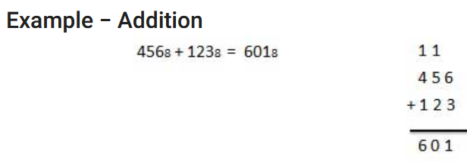
The Octal Addition
Decimal 6+3 = 9
To get the octal value: 9-8 = 1 (always do the carry of 1 to next left most number
5+2=7+1 = 8
8-8=0 ,1
4+1=5+1 =6

Slide 4
The Octal Subtraction
The subtraction of octal numbers follows the same rules as the subtraction of numbers in any other number system.
The only variation is in borrowed number. In the decimal system, you borrow a group of 10₁₀.

Slide 5
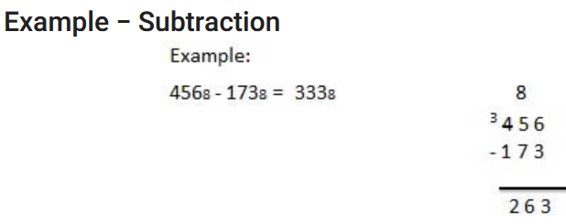
The Octal Subtraction
6-3 =3
5-7 Cannot be Borrow 1 = 8
8+5 =13
13-7=6
3-1=2

Slide 6
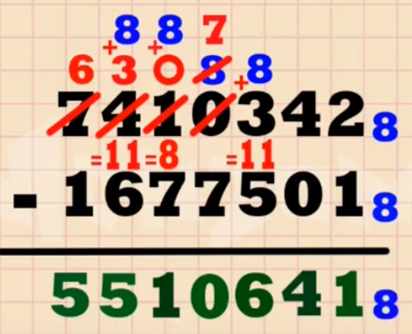
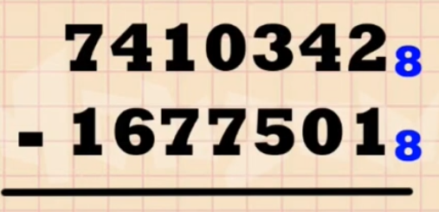
The Octal Subtraction

Slide 7
The Octal Multiplication
The multiplication process of octal numbers are same as other number systems. You can verify your result by using this.
The points you should keep in mind while multiplying octal numbers:
If the sum exceeds 7 ( 0,1,2,3,4,5,6,7) you need to evaluate the equivalent octal value.
Divide the number by 8 and find its equivalent octal value. Quotient is going to be carry while remainder taken as sum

Slide 8
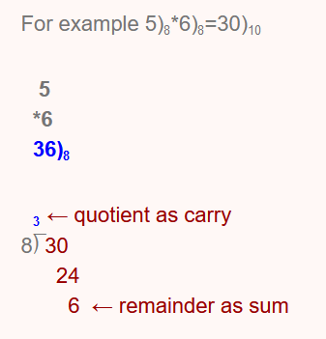
Octal Multiplication
4 1 2
X 2 5
----------
2 4 6 2
+ 1 0 2 4
--------------
1 2 7 2 2

Slide 9
The Octal Division
To solve division examples, you must know how to perform multiplication on octal numbers.
Example:
53
7 ⟌ 457
- 43
-----------
27
- 25
--------------
R= 2

